Slide 1
Public Key Encryption
CSCI 43200 – Security in Computing
Copyright © 2005, 2017 by Scott Orr and the Trustees of Indiana University

Slide 2
Section Overview
Symmetric Key distribution issues
Public Key encryption
Digital Signatures and Hashes
Key Management

Slide 3
References
Computer Security: Principles and Practice, 3rd Ed.
  Chapter 2
  Chapter 21
Online Resources
  Why Johnny Can't Encrypt: A Usability Evaluation of PGP 5.0, Alma Whitten, Carnegie Mellon University

Slide 4
Shared Secret Key Encryption
Alice
Bob
Charlie
Scott
How does Alice distribute the key?
What happens if Scott leaves?

Slide 5
Secret Key Pairs
Alice
Bob
Charlie
Scott
# of Keys = n * (n – 1)/2
Where n is the # of users

Slide 6
Public-Key Encryption
Recipient’s
Public Key
Recipient’s
Private Key
-------
-------
-------
-------
-------
-------
Encryption
++++++
++++++
++++++
++++++
++++++
++++++
Decryption
-------
-------
-------
-------
-------
-------
Plaintext
Ciphertext
Plaintext

Slide 7
PKE Algorithm Components
One or more Prime Numbers
Large integer factoring
Modular arithmetic
Example Algorithms
  Merkle-Hellman Knapsacks
  Rivest-Shivar-Adelman (RSA)
  Diffie-Hellman Key Exchange

Slide 8
Knapsack Concept
0
1
1
Using each block only once, which blocks could be combined to completely fill this space without leaving any open squares inside or block parts outside the highlighted area?
0
1

Slide 9
Merkle-Hellman Knapsacks
Use 1 knapsack for encoding a message
Use a 2nd knapsack for decoding
The knapsacks are mathematically related to each other
  Modulus n
  Multiplier w

Slide 10
Simple Knapsack Generation
Create a simple (superincreasing) knapsack
  Select a (small) initial number
  Each new number is greater than the sum of all previous numbers.
    S = [ 1, 2, 4, 8 ]
Pick n and w
  n is greater than the sum of S
  n and w have no common factors
  Easiest way: set n to a prime number
    n > 15; set n = 17 / Pick w < n; w = 7

Slide 11
Hard Knapsack Generation
Hard knapsack is a function of S, w, and n
  h_{i} = s_{i} * w mod n
  h₁ = 1 * 7 mod 17 = 7
  h₂ = 2 * 7 mod 17 = 14
  h₃ = 4 * 7 mod 17 = 11
  h₄ = 8 * 7 mod 17 = 5
  H = [ 7, 14, 11, 5 ]
H becomes the public key
S, n, and w together become the private key

Slide 12
Encrypting a Message
Message is broken down in binary blocks
Block size = number of elements in H
Calculate sum of PT * H for each block
This becomes the encrypted message
PT = 1011 0110 1010 0101 / H = [ 7, 14, 11, 5 ]
Sum₁ | = 7 + 11 + 5 | = 23
Sum₂ | = 14 + 11 | = 25
Sum₃ | = 7 + 11 | = 18
Sum₄ | = 14 + 5 | = 19
Message M = [ 23, 25, 18, 19 ]

Slide 13
Decrypting a Message
Need to find inverse v of w:
  w * v mod n = 1
  Use Extended Euclidean Algorithm to find v
    7 * v mod 17 = 1; v = 5
Calculate new sum totals: M_{i} * v mod n
M = [ 23, 25, 18, 16 ] / Sum_{i} = M_{i} * 5 mod 17
Sum₁ | = 23 * 5 mod 17 | = 13
Sum₂ | = 25 * 5 mod 17 | = 6
Sum₃ | = 18 * 5 mod 17 | = 5
Sum₄ | = 19 * 5 mod 17 | = 10

Slide 14
Decrypting the Message (con’t.)
To get the plaintext, we now use S
  S * PT_{i} = Sum_{i}
  Sum₁ = 13 = [ 1, 2, 4, 8 ] * PT₁; PT₁ = [1011]
  Sum₂ = 6 = [ 1, 2, 4, 8 ] * PT₂; PT₂ = [0110]
  Sum₃ = 5 = [ 1, 2, 4, 8 ] * PT₃; PT₃ = [1010]
  Sum₄ = 10 = [ 1, 2, 4, 8 ] * PT₄; PT₄ = [0101]
  PT = 1011 0110 1010 0101

Slide 15
RSA Public Key Encryption
Developed by MIT professors Ron Rivest, Adi Shamir and Len Adleman (1977)
Message blocks treated as a large number less that some number n
Block size 2^{k} bits ⇨ 2^{k} < n < 2^{k+1}
Relies on:
  Large prime numbers
  Large number factoring
  Modular arithmetic

Slide 16
RSA Key Generation
Select 2 prime numbers, p and q
Let n = p * q
Let φ(n) = (p – 1)(q – 1)
Pick e that is relatively prime to φ(n)
Find d ⇨ d = e⁻¹ mod φ(n) ⇨ de = 1 mod φ(n)
Generated keys:
  Public: e & n
  Private: d & n

Slide 17
RSA Encryption & Decryption
Encryption:
  Break message into M sized blocks < n
  Cipher C = Me mod n
Decryption:
  Message M = C^{d} mod n

Slide 18
RSA Example
Key Generation:
  Let p = 5 and q = 11
  N = 5 * 11 = 55
  φ(n) = (5 – 1)(11 – 1) = 40
  Let e = 3
  Find d ⇨ 3d = 1 mod 40; d = 27
Encrypt M = 5 ⇨ C = 5³ mod 55 = 15
Decrypt C ⇨ M = 15²⁷ mod 55 = 5

Slide 19
Digital Signatures
Sender’s
Private Key
Sender’s
Public Key
-------
-------
-------
-------
-------
-------
Hash
Encryption
------
------
------
------
++++++
++++++
Hash
Decryption
-------
-------
-------
-------
-------
-------
Plaintext
Signed
Message
Plaintext

Slide 20
Hash Functions
Accept messages of any size and generated a small, fixed size output
One way function
Easy and fast to calculate
Collision Resistant

Slide 21
XOR Example
Break message into fixed length blocks
XOR first element of all blocks
Repeat for all elements
G 0 1 0 0 0 1 1 1
o 0 1 1 0 1 1 1 1
n 0 1 1 0 1 1 1 0
o 0 1 1 0 1 1 1 1
w 0 1 1 1 0 1 1 1
0 1 0 1 1 1 1 0
5 E
Not very collision resistant!!!
Source: Classical and Contemporary Cryptology
by Richard J. Spillman

Slide 22
MD5 Hash
Developed by Ron Rivest
Generates a 128-bit hash
Initialization
  Pad message (1 followed by n 0s) such that the message size is 448 mod 512
  (message size) mod 2⁶⁴ appended to message as 64-bit number
  4 32-bit registers used store intermediate and final results
  512-bit message block processed in 4 rounds, each consisting of 16 stages

Slide 23
MD5 Rounds
Block_{i}
D
F
T[1..16]
G
T[17..32]
H
T[33..48]
I
T[49..64]
+
D
CV_{i}
C
+
C
CV_{i+1}
B
+
B
A
+
A

Slide 24
MD5 Stage
G
D
D
C
C
B
B
A
+
+
+
Rot
+
A
Block_{i}[k]
T[j]

Slide 25
SHA-1 Rounds
Block_{i}
E
F
W[1..19]
G
W[10-39]
H
W[40-59]
I
W[60..79]
+
E
D
+
D
CV_{i}
CV_{i+1}
C
+
C
B
+
B
A
+
A

Slide 26
SHA-1 Stage
W_{i}
K_{i}
E
+
+
+
+
E
G
D
D
C
C
B
S³⁰
B
A
S⁵
A

Slide 27
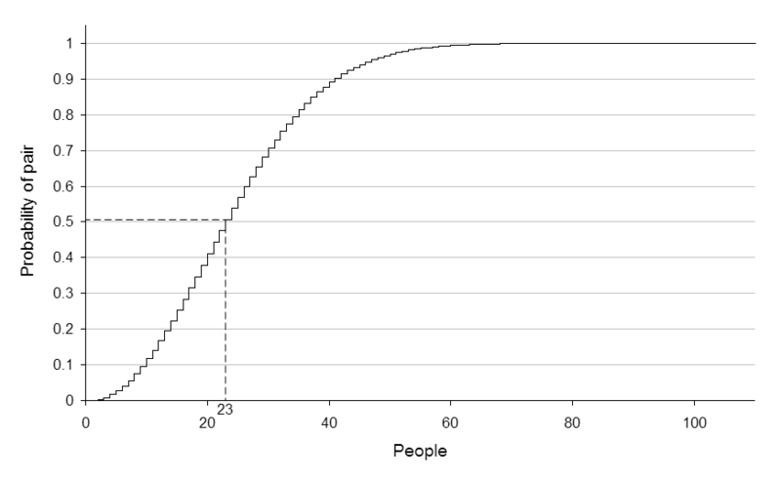
Birthday Paradox

Slide 28
El Gamal Keys
Choose a large prime number, p, such that (p – 1) has a large prime factor, q
Select 2 integers, x and a, such that x < p and a < p.
Calculate y = a^{x} mod p
  Private Key: x
  Public Key: y, p, a

Slide 29
El Gamal Signatures
Used to sign message, m
Select an integer k such that:
  0 < k < p – 1
  Not used previously
  Relatively prime to (p – 1)
Message signature is r and s
  r = a^{k} mod p
  s = k⁻¹(m – xr) mod (p – 1)

Slide 30
El Gamal Signatures (Con’t)
Checked:
  Calculate y^{r}r^{s} mod p
  Should be same as a^{m} mod p
Digital Signature Standard (DSS)
  Based on El Gamal
  2⁵¹¹ < p < 2⁵¹²
  2¹⁵⁹ < q < 2¹⁶⁰
  Uses a hash (SHA-1) instead of m
  q, instead of (p – 1) is used to calculate r and s

Slide 31
Diffie-Hellman Key Exchange
Bob and Alice together select a prime number, p, and a base, g
Alice:
  Selects secret number a
  Sends Bob gª mod p
Bob:
  Selects secret number b
  Sends Alice g^{b} mod p
Shared secret: k
  k = (gª mod p)^{b} mod p = (g^{b} mod p)ª mod p
  Used as key in symmetric cryptography algorithm

Slide 32
“Pretty Good Privacy”
Freely available PKE system
Minimizes email forging
Promotes privacy
Requires a Circle of Trust
Alternatives
  MIME Object Security Services (MOSS)
  Security Multiparts for MIME (S/MIME)

Slide 33
Public Key Distribution
Sent via disk/email
Downloaded from web page
Public Key Server
Fingerprints and key signing
Public Key Infrastructure
  Certificate Authorities
  Registration Authorities
  Certificate Distribution System
  Key Escrow

